Slide 1
Problem identification
How can Big Mountain Resort increase revenue by more than $1.54 million (the operating cost associated with installing an additional chair lift) this season by appropriately pricing their ski ticket, cutting costs without undermining the ticket price or modifying features of their resort to support a higher ticket price?

Slide 2
Recommendation and Key Findings
Scenario | Support for Ticket Price | Change in Revenue for This Season
Permanently close up to 10 least used runs | Reduce | Decrease
-Add a run (increase vertical drop by 150 ft) -Install an additional chair lift | Increase by $1.99 | Increase by $3.5 million
-Add a run (increase vertical drop by 150 ft) -Install an additional chair lift -Add 2 acres of snow making cover | Increase by $1.99 | Increase by $3.5 million
-Increase longest run by 0.2 mile (total length: 3.5 miles) -Additional snow making of 4 acres | No change | No change
Big Mountain Resort currently charges $81 for an adult weekend ski lift ticket.
Big Mountain Resort modelled price is $95.87

Slide 3
Modeling Results and Analysis
Model: Random Forest Regression
Imputation of missing values using median
Performance metric: mean absolute error calculated using cross-validation of 5
Target: adult weekend ski ticket price
Features: vertical drop, snow making, total chairs, fast quads, runs, longest run, trams, skiable terrain
Training data: data from ski resorts in the US
Not including Big Mountain Resort
Test data: Big Mountain Resort data

Slide 4
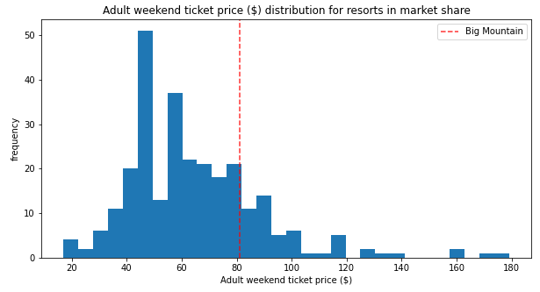
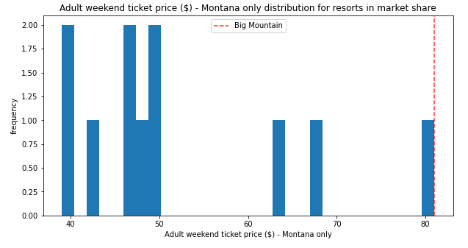
Ticket Price Distribution

Slide 5
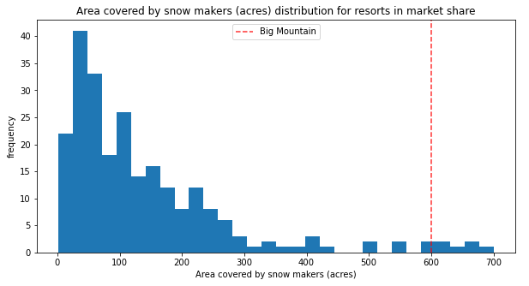
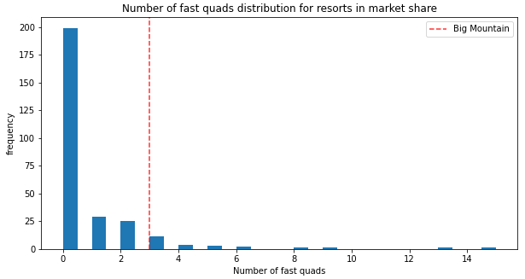
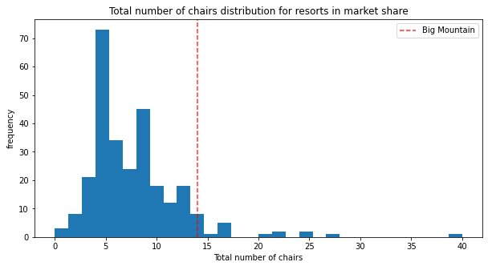
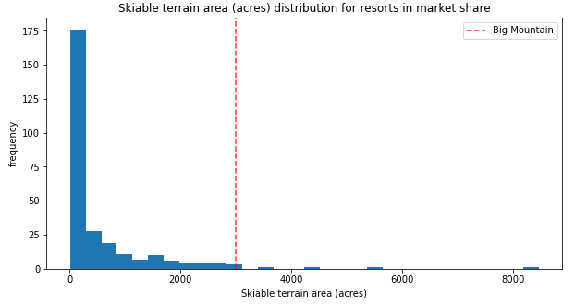
Big Mountain Features: Better Than Other Resorts
Area covered by snow making
Total number of chairs
Number of fast quads (Big Mountain has 3)
Skiable Terrain

Slide 6
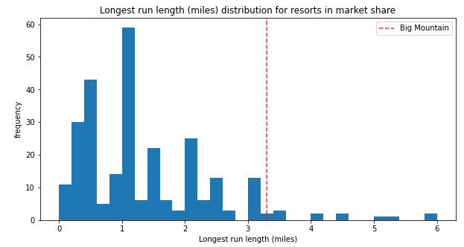
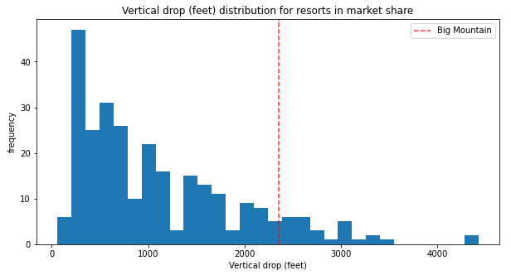
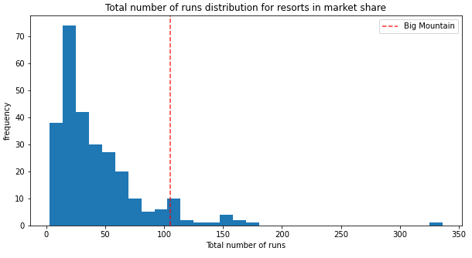
Big Mountain Features: Areas for Improvement
Longest run
Vertical drop
Other resorts with greater drop
Number of runs

Slide 7
Summary and Conclusion
Of the four scenarios modelled,
Best scenario for increasing revenue this season:
Add a run, increasing the vertical drop by 150 feet
Install an additional chair lift
Expected change from scenario this season:
Increase support for ticket price by $1.99
Increase revenue by $3.5 million
Big Mountain Resort modelled price is $95.87

